Slide 1
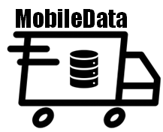
App-stracting Insights
EBA5006: Graduate Certificate in Big Data Analytics
Ang Mei Chi | (A0269733R)
Lew Kuan Teng Roy | (A0124354M)
Liu Wudi | (A0269809J)
Michael Wong Wait Kit | (A0269491N)
Ong Wee Yang | (A0017030A)

Slide 2






Presentation Outline
Introduction & Data Ingestion
Batch Data Processing & Storage
Machine Learning Model Integration (RCS)
Connectivity to Power BI & Dashboard Visualizations
Monitoring, Logging, Conclusion/Retrospective
Roy
Mich
MC
WY
WD

Slide 3
Introduction
Project Objectives

Slide 4
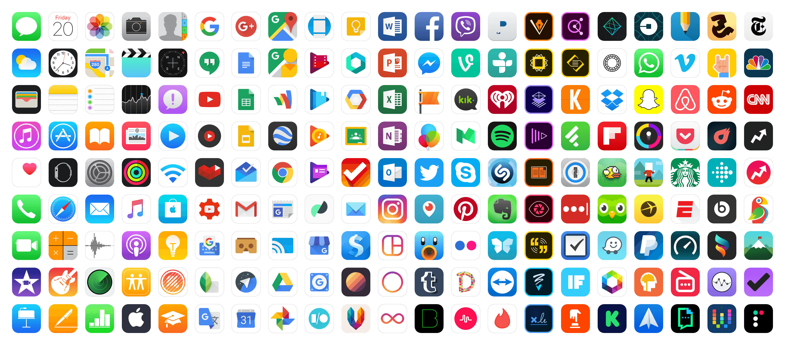
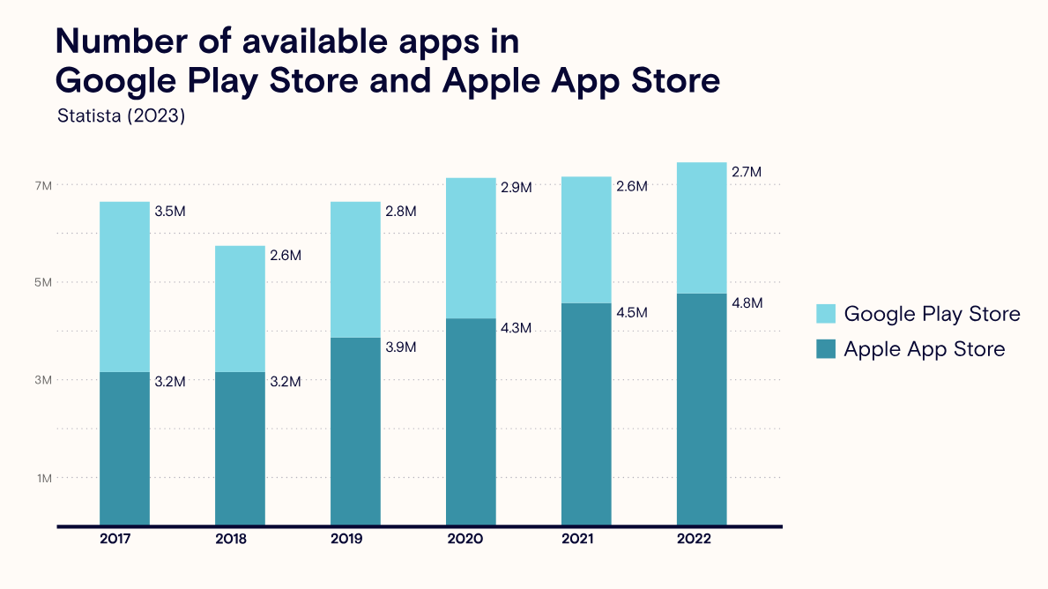
Q1 22: 37B downloads

Slide 5

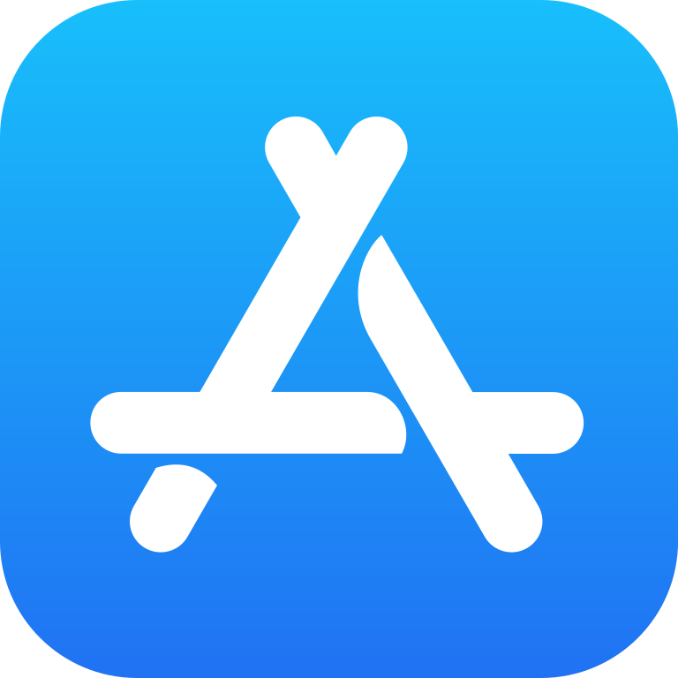
Project Objectives
Achievable and Scope
Conduct trend analysis across categories on the Apple App Store and Google Play Store to understand app popularity and distribution
Perform comparative market analysis between Apple App Store and Google Play Store to identify unique trends
Analyze key factors/features that drive app installs and explore predictive models for apps installs

Slide 6


Methodology and Framework
CRISP-DM vs TDSP

Slide 7
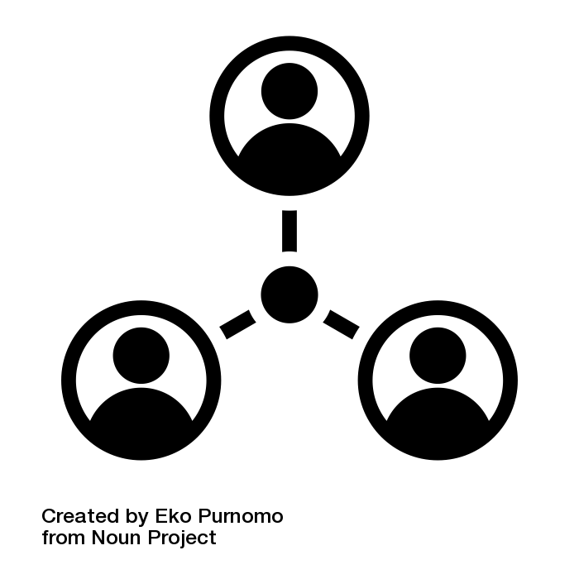



Customers
Interested Parties. Stakeholders & Beneficiaries
App Developers
Insights into app trends, user preferences and factors driving app installs
App development strategies (user engagement)
App Development Companies
Guide product roadmap
Improve competitiveness of app in market
Digital Marketers
Tailor advertising/promotion strategies
Targeted audience, improve ROI

Slide 8
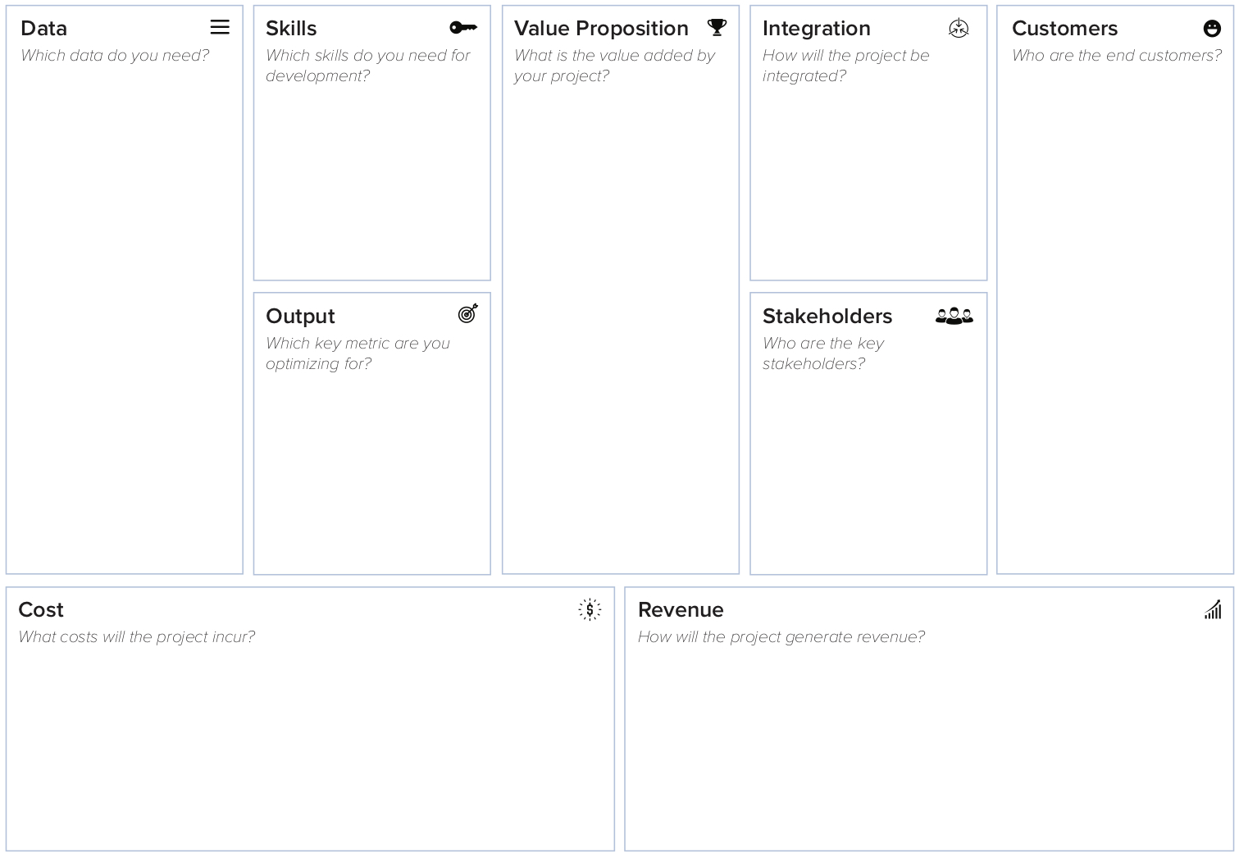




App Feature Data
Web scraping
API
Empowers app developers with actionable insights for enhanced user engagement and optimized strategies
App Developers
Google Play Store
GCP
GBQ
Apple App Store
Power BI
Drives data-driven decisions in app development, enhancing performance and revenue
PySpark
GitHub
User Reviews Data
Facilitates predictive modeling for app install forecasts, aiding strategic planning and investment
High recall and accuracy rate (> 70%)
App Developers
Marketing teams
AI Canvas
Revenue stream per app
SME/Business Executive of App Company
User satisfaction ratings
Google Cloud Storage cost
Manhour savings from market app analysis
Data query and ETL pipeline cost
Better market position (potential revenue and business growth)
Google Cloud Infrastructure cost
Notes:
KIV

Slide 9
Project
Stages and Data Architecture

Slide 10


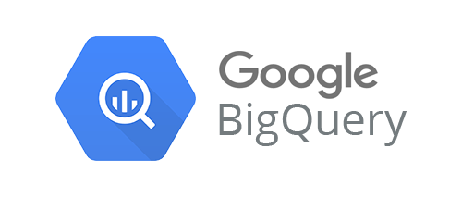
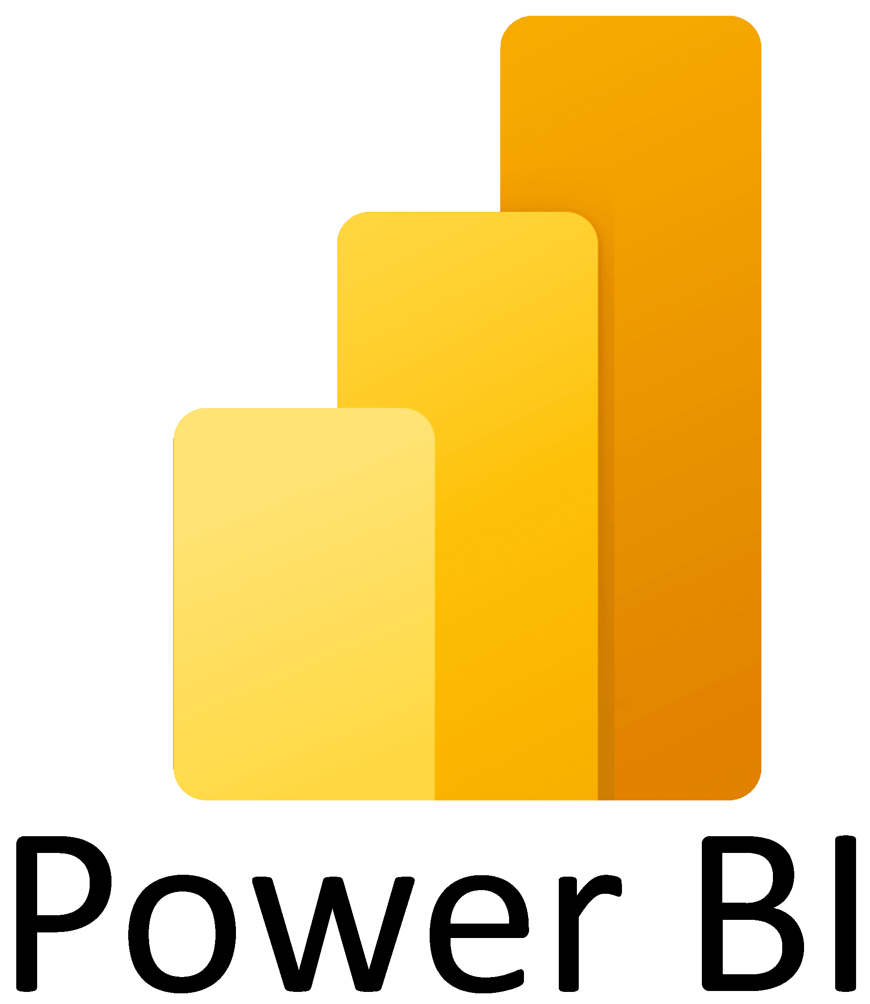




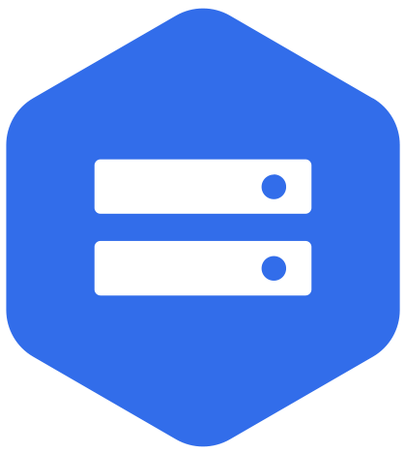

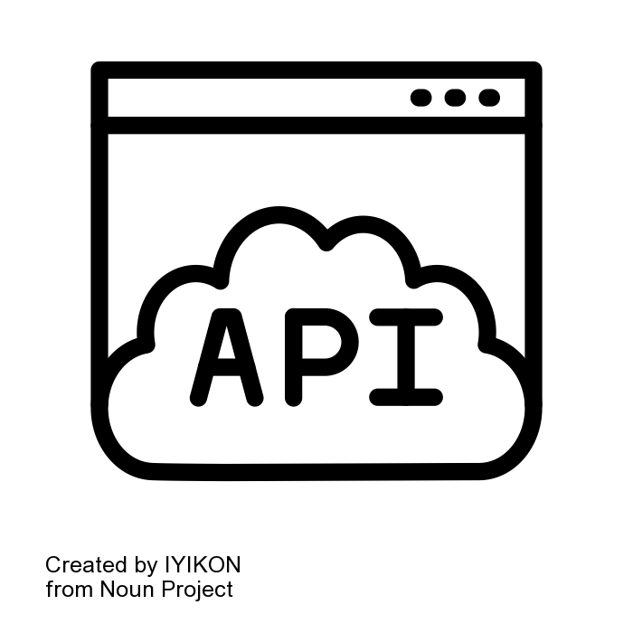


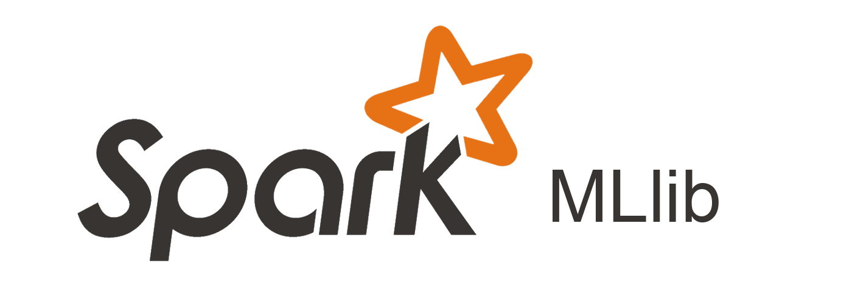


Data
Processing
Analytics
Solution
Data Pipelines
Ingestion
Storage
Data Source
Main Storage
Batch
Processing
Dashboard
GitHub
Action
Temporary Storage
Data Extraction
EDA
Model Exploration
Classification
Recommenders
Code Versions
Notes:
Pros
GitHub Action comes with VM to run script (PySpark compatible) + Scheduler + Repository, all bundled together at no cost
Cons
Schedule timing not accurate (+/- 30 mins) & slower run time
Command Run On

Slide 11

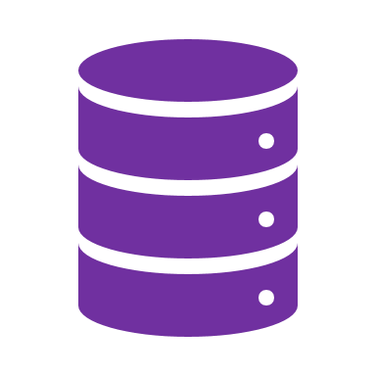
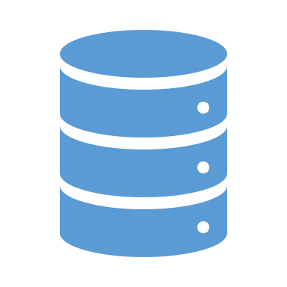



BIG DATA
rchitecture
Cloud Data Lake/Warehouse
Data Lake
Data Warehouse
Business Intelligence
Scheduled
Ingestion
rawData
cleanData
modelData
rawData
cleanData
GitHub Action
Linux VM
Ubuntu-latest

Slide 12
Data Sources
Availability and Understanding

Slide 13
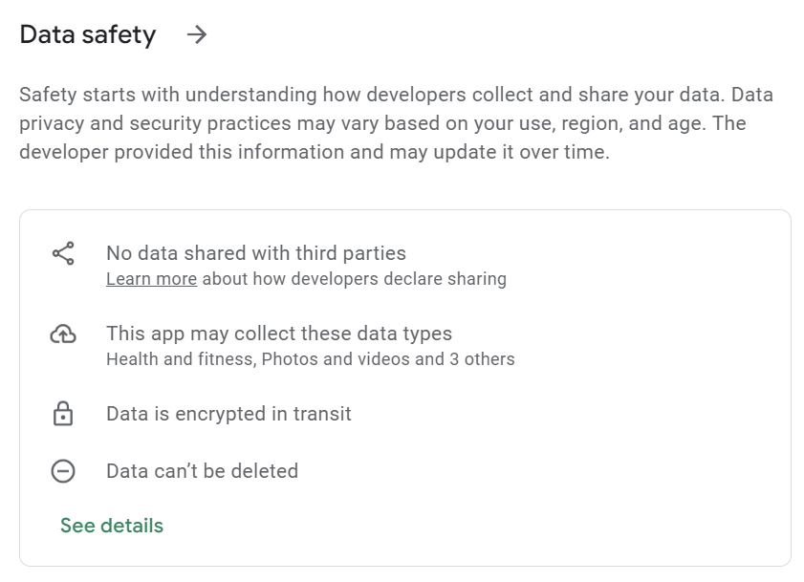
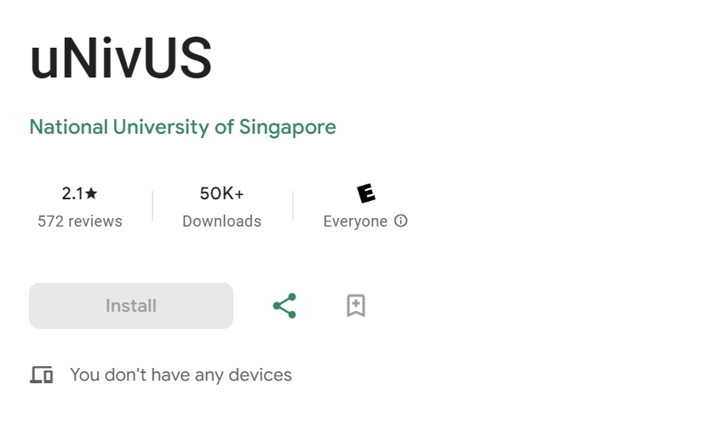

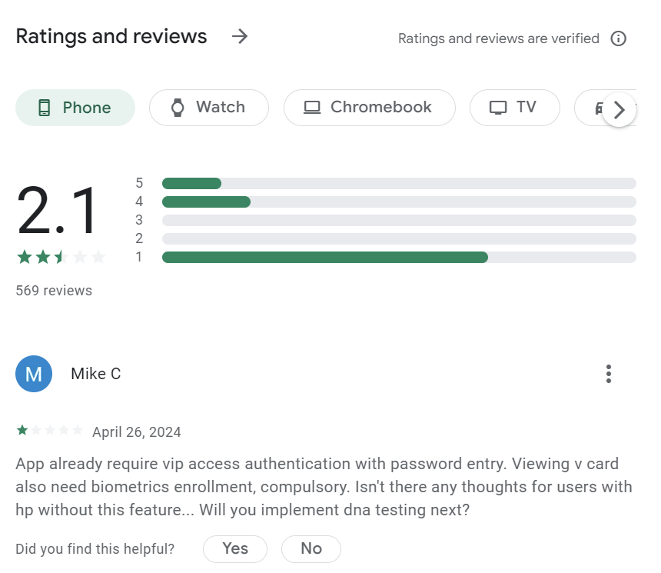
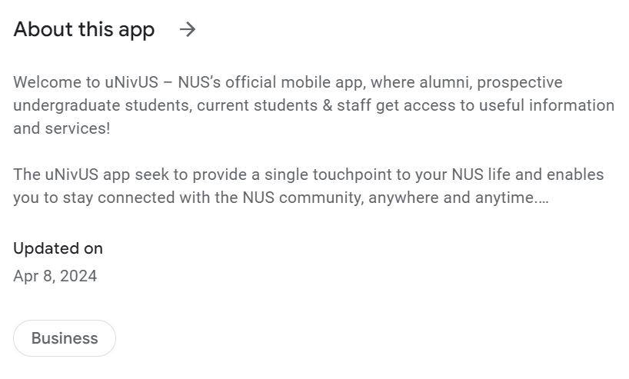
Web scraping
Extracting data from websites
App Security Configuration
App Name
Genre
# of Reviews
# of Downloads
App Scores
App Description (updates)
Rating Distribution
Reviews
(recent/rating)

Slide 14
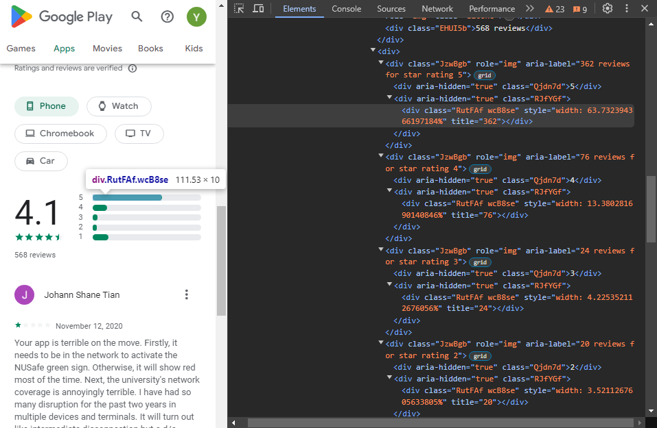
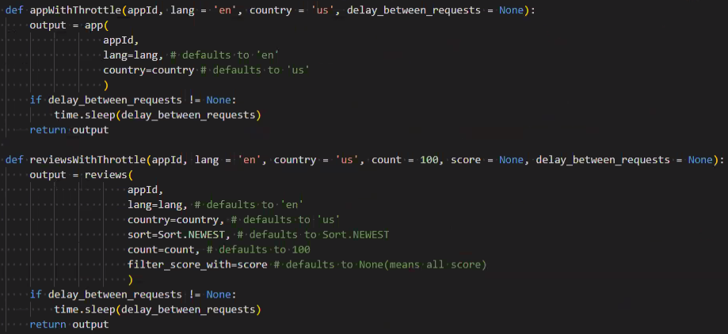
Web scraping & API
Extracting data from websites

Slide 15

Data Understanding
S/N | Original Column | Data Type | Description
0 | c0 | integer | column number generated by spark
1 | title | string | app title
2 | description | string | app description
3 | descriptionHTML | string | app description (copy)
4 | summary | string | app summary
5 | installs | string | app installs (categorical)
6 | minInstalls | string | mininum installs following 'install' column
7 | realInstalls | string | no. of real instals
8 | score | string | score
9 | ratings | string | no. of ratings, average is equivalent to score
10 | reviews | string | no. of reviews
11 | histogram | string | distribution of stared ratings
12 | price | string | price of app
13 | free | string | whether app is free for download
14 | currency | string | currency of store (eg. USD)
15 | sale | boolean | Sale (All false)
16 | saleTime | string | time of sale (All None)
17 | originalPrice | string | app original price (All None)
18 | saleText | string | sale text (All None)
19 | offersIAP | boolean | whether app offers In-App Purchases (IAP)
20 | inAppProductPrice | string | IAP price range
21 | developer | string | developer name
22 | developerId | string | developer Id
23 | developerAddress | string | developer Id address
24 | genre | string | app genre
25 | genreId | string | app genre id
26 | categories | string | dictionary of app genre and genre id, may include genres besides in 'genre' column
27 | contentRating | string | content rating eg. Everyone, Teen etc
28 | contentRatingDescription | string | content rating description eg. Fantasy Violence, Simulated Gambling
29 | adSupported | string | supports ads or not (True/False)
30 | containsAds | boolean | contains ads or not (True/False)
31 | released | string | App released date
32 | lastUpdatedOn | string | App version last update release date
33 | Updated | string | String of numbers, undecipherable
34 | Version | string | App version
35 | appId | string | App Id (PK)
No explicit explanation or metadata on the columns
Systematic process to interpret and understand the data
Data type/structure analysis
Column name
Data inspection and profiling

Slide 16


Data Cleaning
Row Reduction
Null value
<10 downloads
Reviews of prefiltered apps
Data Lake
Data Warehouse
Eg. Google Apps
rawData
cleanData
modelData
App Details
App Reviews
~1m rows x 36 columns
~1.5m rows x 12 columns
~540k rows x 31 columns
~730k rows x 11 columns

Slide 17
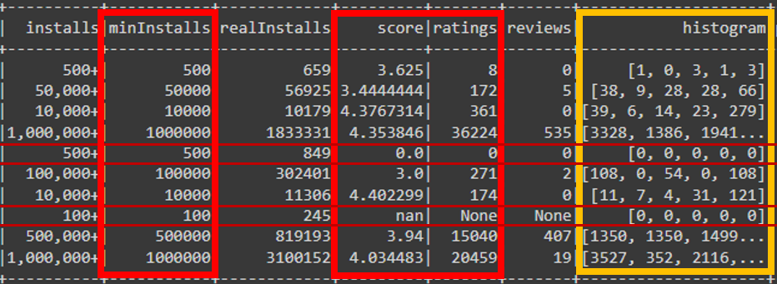
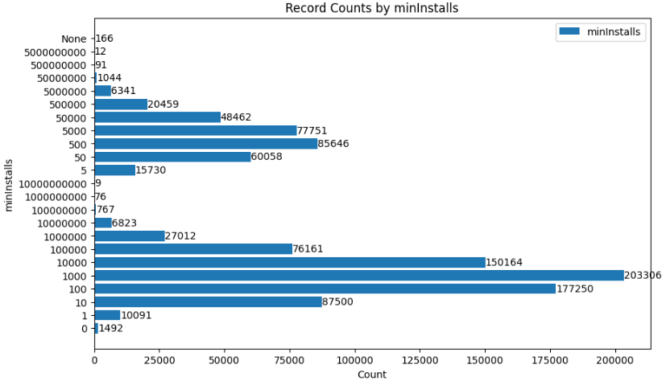
nan – “not a number”, missing or undefined numeric values
None – Null or absence of value
minInstalls
Notes:
- set a higher threshold condition for minInstalls to reduce row/app?

Slide 18
Detect Language using langdetect
Python library used for language detection and identification
Other languages identified
Total Review Count: 727,601
Distinct language identified: 56 (1 unknown)
Top 10 languages:
Notes:
- 20 most recent reviews/app
- As relevant real-time insights

Slide 19
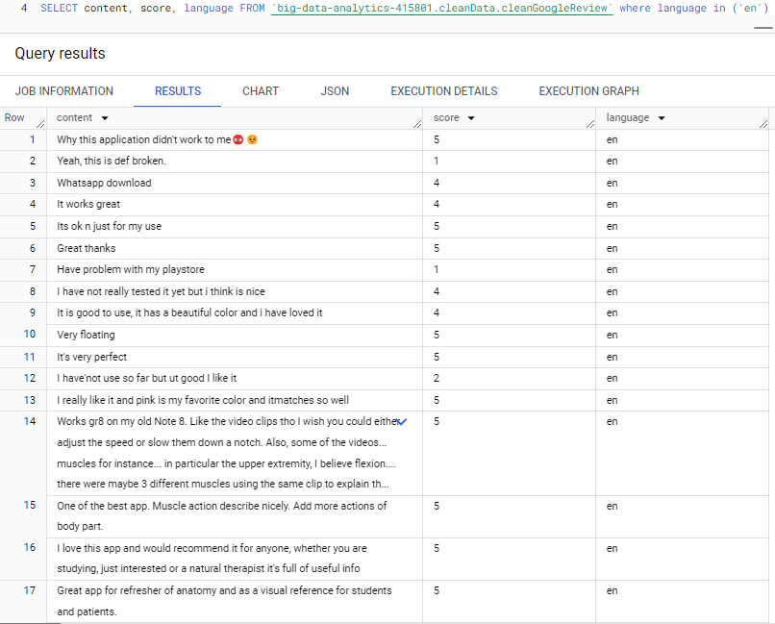
Detect Language using langdetect
Python library used for language detection and identification
Total Review Count: 727,601
Distinct language identified: 56 (1 unknown)
Top 10 languages:
Notes:
- 20 most recent reviews/app
- As relevant real-time insights

Slide 20
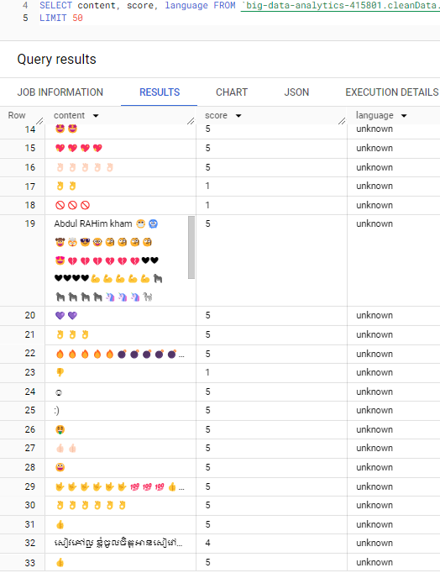
Detect Language using langdetect
Python library used for language detection and identification
Total Review Count: 727,601
Distinct language identified: 56 (1 unknown)
Top 10 languages:
Notes:
- 20 most recent reviews/app
- As relevant real-time insights

Slide 21
Data Batch Processing and Storage
GitHub Scheduler, Workflow and everything in between

Slide 22
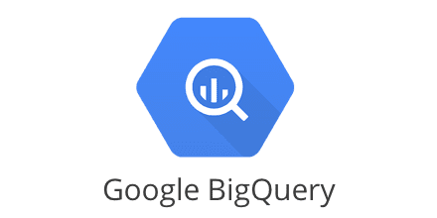



















Dataset – container for managing Tables
Table – collection of data in rows and columns
Serverless Data Warehouse
select * from ‘big-data-analytics-415801.rawData.appleMain`;
Production
Data ingestion
- Large amount of data
- Data Extraction/Retrieval > 6hrs (Initial Test)
Workaround
- Split whole data into 40 groups
- Run 40 jobs (workflows)
(x2 20 concurrent jobs, ~ 12hrs/round)
API
prod_rawData
prod_cleanData
prod_modelData
appleMain
CleanAppleMain
ModelApple
Recommendation
prod_dateTimeData
Webscrape
appleReview
CleanAppleReview
datetime
1-40
googleMain
CleanGoogleMain
ModelGoogle
Recommendation
googleReview
CleanGoogleReview
48 Workflows
1-26: Apple Data Ingestion
27-40: Google Data Ingestion
41: Apple Data Wrangling
42: Google Data Wrangling
43: Apple Classification Model
44: Google Classification Model
45: Apple Recommendation Model
46: Google Recommendation Model
47: Date & Time
48: Create Development Raw Data
dev_rawData
dev_cleanData
dev_modelData
appleMain
CleanAppleMain
ModelApple
Recommendation
dev_dateTimeData
appleReview
CleanAppleReview
datetime
googleMain
CleanGoogleMain
ModelGoogle
Recommendation
googleReview
CleanGoogleReview
Development
48
Notes:
nusebac@gmail.com
Nusebac1990
This is a diagramic overview of how our data will flow through the pipelines. We will ingest data, create a copy at a slice in time and push it to Development pipeline for testing. Once the workflow is built and tested to work well, we will change the path to the Production pipeline for Deployment
Google Big Query, aka GBQ, is used as our Database storage of choice. The ‘dev’ and ‘prod’ initials are the folder names within GBQ
We created 48 workflows for this project, which will be explained in detail later (with actual screenshots of our codes and database)

Slide 23
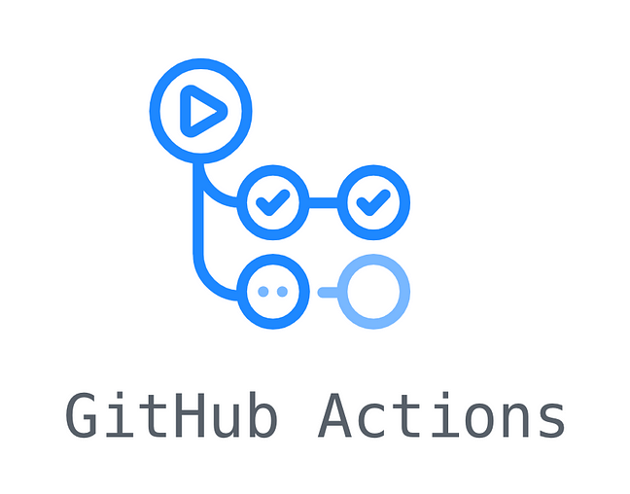
GitHub repository structure
Top layer
actions1-48.yml files (workflows)
Runners (‘virtual machines’)
Middle layer
main.py
Bottom layer
dataIngestionApple.py, dataIngestionGoogle.py,
dataWrangling.py, models.py
Supporting files
Common.py, requirements.txt, etc
Notes:
Moving on, this is another overview but on how our repository is structured
The whole repository structure is built upon FUNCTIONAL THINKING concept. We can imagine that the repo is split into 3 layers, top layer as the overall high level layer, before going down to the middle layer, and then finally to the bottom layer where those scripts does all the heavy lifting
The Common file is to store common functions that will be used across different files in the repo, while ..
The Requirements file is to instruct the runner what packages to install for running the python codes

Slide 24
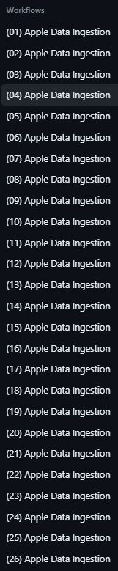
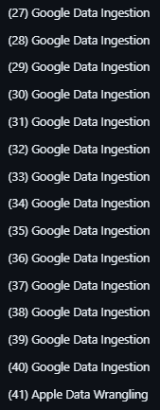
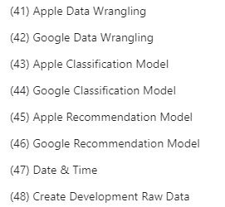
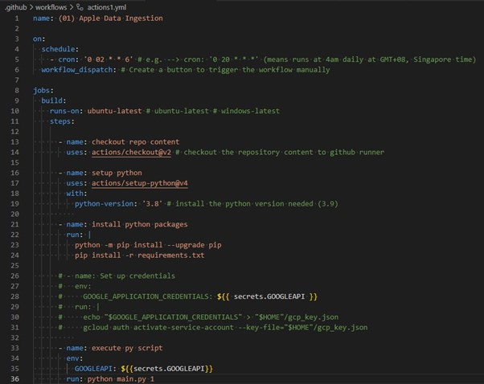
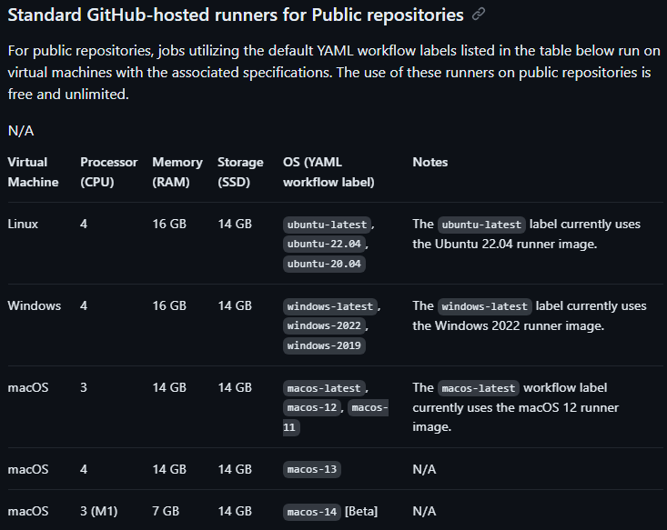
Yml files
Data Batch Processing and Storage
GitHub Scheduler, Workflow and everything in between
Workflow files that instructs GitHub Actions to carry out a set of actions
40 for data ingestion, 2 for data wrangling, 4 for ML modelling, 1 to create training dataset, 1 to create date & time table
A Runner will be assigned
ubuntu-latest (LINUX machine, quad-core processor)
Top layer
actions1-48.yml files (workflows)
Middle layer
main.py
Bottom layer
dataIngestionApple.py, dataIngestionGoogle.py,
dataWrangling.py, models.py
Notes:
Per workflow yml file, a Runner will be assigned and execute instructions on the script
Runs on a Linux machine (best choice for working with Pyspark)
Manually created the 48 .yml files
-Scheduling is done here using CRON syntax. We set it to run every Saturday (once a week)
-As we can see under ‘jobs’, GitHub Actions reads the runner this workflow should run on, which is the ‘ubuntu-latest), then install the python version needed, then install the necessary python packages, and then finally run the python script (main.py)
-Note that there is a hard-coded variable created after main.py which will be used for identifying which workflow to execute later

Slide 25
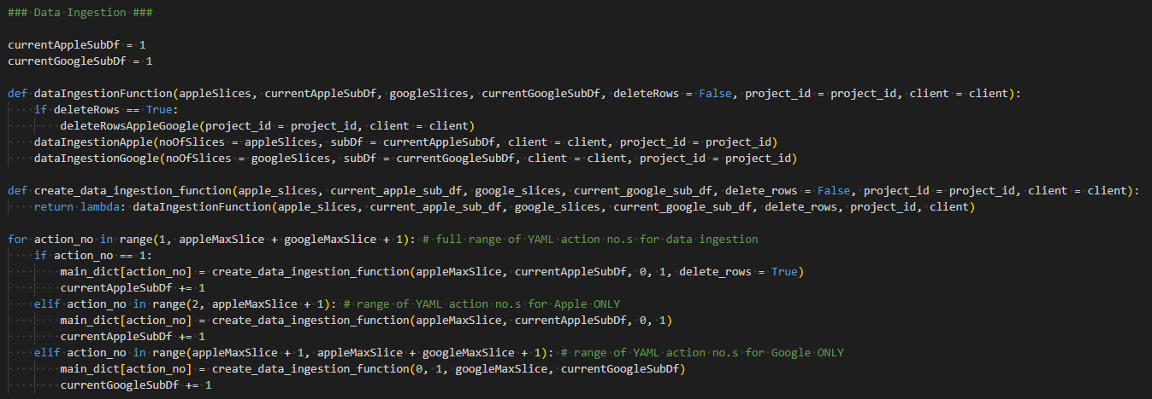
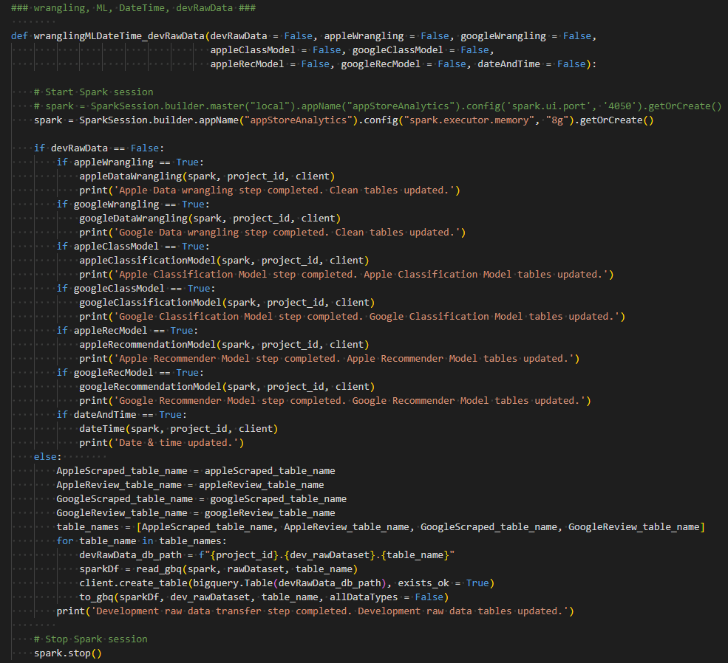
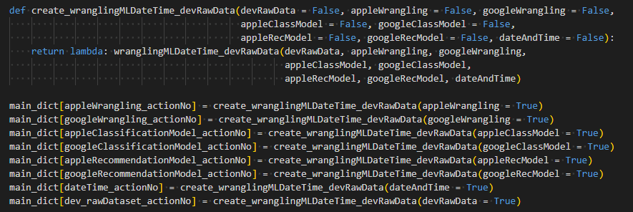
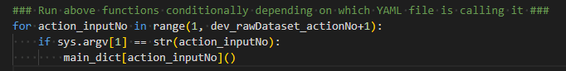
Main.py
To create a dictionary to store respective downstream functions
Data ingestions, data wrangling, ML modelling
Read .yml variables under ‘execute Python script’ section to run the functions
Top layer
actions1-48.yaml files (workflows)
(1. Define Ingestion function)
Middle layer
main.py
(2. Define Wrangling/ ML/ Date Time/ create training data functions)
Bottom layer
dataIngestionApple.py, dataIngestionGoogle.py,
dataWrangling.py, models.py
(3. Run functions)

Slide 26
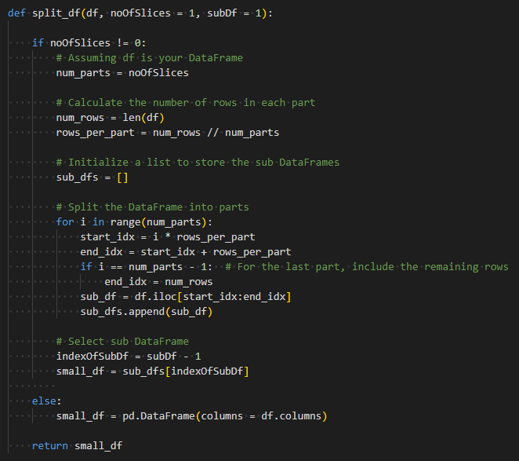
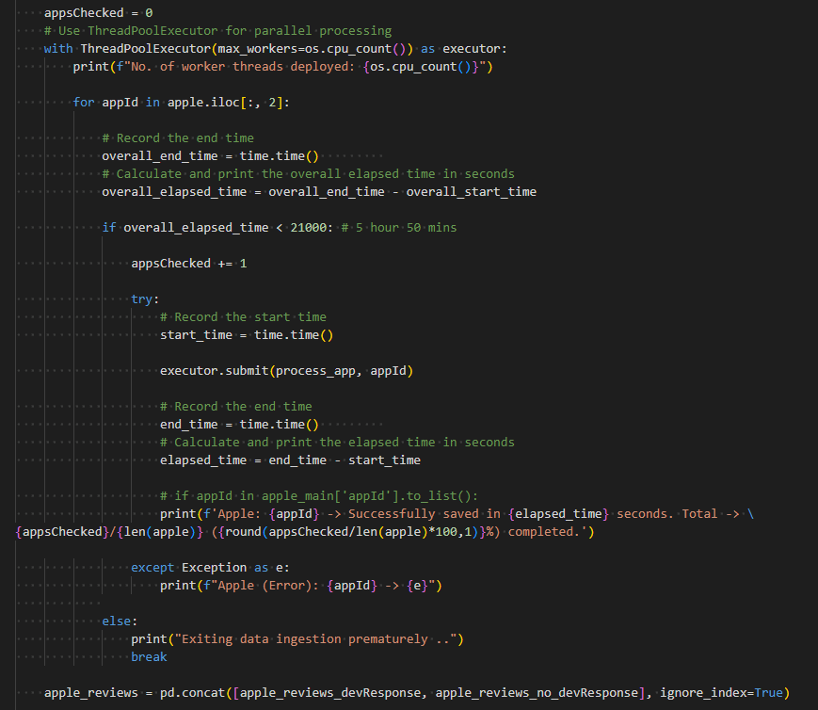
Data Ingestion
Done via reading a list of Apple & Google application IDs that is found on GitHub
[Limitations]
API & web scrapping method runs too slowly
GitHub Actions (free)
Maximum of 6 hours runtime per Runner’s workflow
Maximum of 20 Runners deployable simultaneously
(Split function)
Top layer
actions1-48.yaml files (workflows)
Middle layer
main.py
[Solutions]
Split into 40 separate workflows (26 Apple & 14 Google), running 20 workflows simultaneously 2 times, back-to-back
API/ web scrapping function will iterate through sub list and append outputs to a data frame
Once completed, each of the runner will append the results to the respective GBQ tables
Split function created in Common.py
Enabled multi-threading to run all 4 worker threads per runner in parallel, increasing processing speed by 4x
Bottom layer
(Multi-threading)
dataIngestionApple.py, dataIngestionGoogle.py,
dataWrangling.py, models.py
Notes:
Data list credits to Gautham Prakash
This list was last updated in 2022, but should the list get updated, our codes can dynamically pull the new list of app Ids and run the respective api and webscrapping functions to get the new data we need.
Roy to put in API part in intro!!
-To get around the 6 hour time out limitation, and to speed up the data ingestion process .. We decided to split into 40 workflows for data ingestion
-We break the list (per Apple and Google) to into 26 and 14 parts respectively, and each of this part is sent to a runner. The API/ web scrapping function will then iterate through this sub list and the outputs are appended to a dataframe. Once completed, each of the runner will append the results to the respective GBQ tables
-Along with the split function, read and to gbq functions are also defined in the Common file which will be used across various parts of the workflow
-Since our server is a quad core processor, we also enabled multi threading to run all 4 worker threads in parallel, thus speeding up the process by 4x.

Slide 27
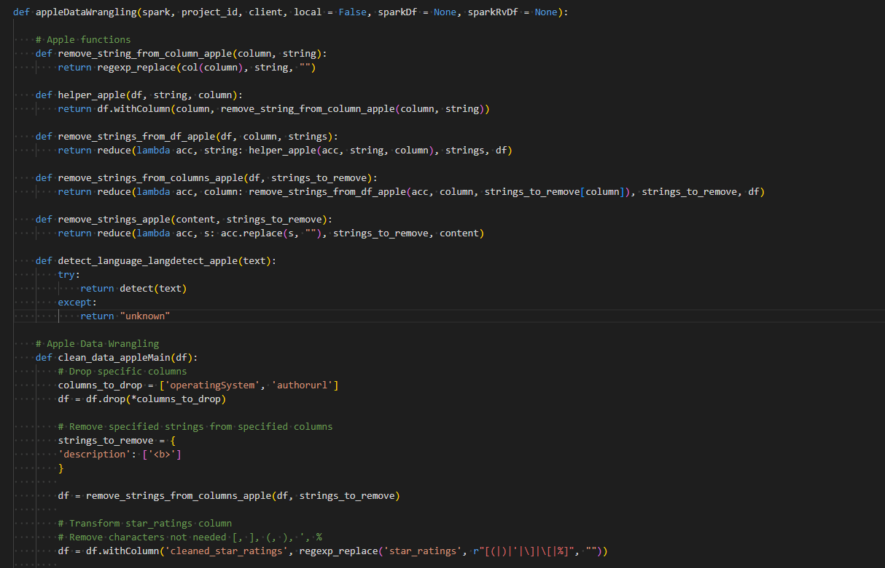
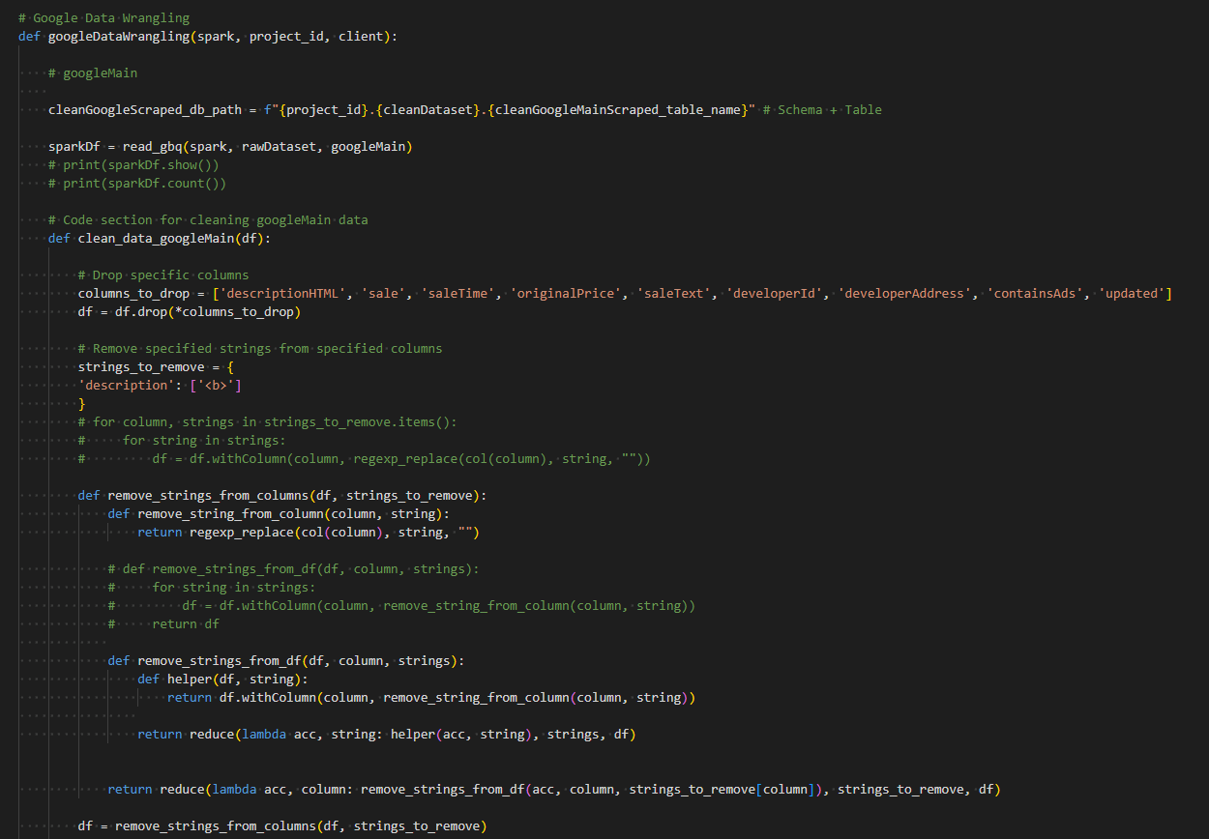
Data Wrangling
Data wrangling script reads the raw data and process it to clean format
Fully done via the Spark framework
Cleaned datasets pushed to Google Big Query
Top layer
actions1-48.yaml files (workflows)
Middle layer
main.py
Bottom layer
dataIngestionApple.py, dataIngestionGoogle.py,
dataWrangling.py, models.py
(Apple data wrangling snippets)
(Google data wrangling snippets)
Notes:
- After the raw data is ingested, the wrangling script will read the raw data and process it to clean format. The data types will also be stored in its correct format for each column.
- Fully done via the spark framework to simulate parallel processing
- Similarly, once the data is cleaned for all 4 files, it will be pushed to the clean tables in gbq, ready for dashboarding and modelling.

Slide 28
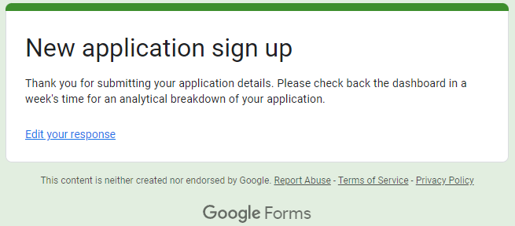
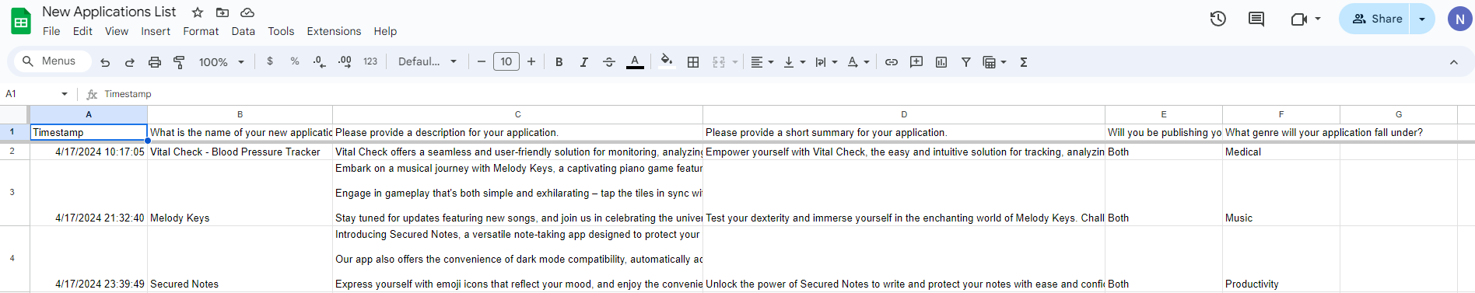
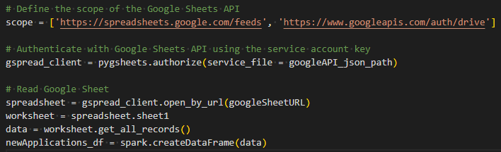
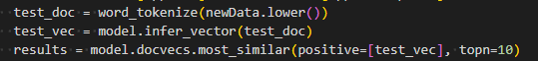
ML modelling
Training
Models were initially trained using development datasets on Google Colabatory
Deployment
Models subsequently deployed to Production
New data (model features) are introduced when developers enters their new application information here:
https://docs.google.com/forms/d/e/1FAIpQLSdcbV56ISkxl8vF-XLXpqkmeDCAAbBygcL5pYUKNY7Vd-0jcg/viewform
Pipeline:
Model outputs pushed to Google Big Query
Top layer
actions1-48.yaml files (workflows)
Middle layer
main.py
Bottom layer
1. Google Forms
2. Google Docs
3. Data frame in model.py
4. Model function codes in model.py
dataIngestionApple.py, dataIngestionGoogle.py,
dataWrangling.py, models.py
Notes:
Once the timing for wrangling is done, the yml file will kick start the next workflow to run the modelling file.
Models were initially trained using development datasets via Colab
After hyperparameters are tuned, models are then subsequently deployed
We developed a google form to allow developers to key in some key information about their new applications. namely, the name, app description, and whether they want to publish to apple or google or both platforms
Once the submission is made, the data will be read into a google docs spreadsheet automatically. These data will be the input features for our models. Our workflow will then pick up these new data from the google docs, read it as a DF, and eventually run through our model function codes; .. and the model outputs will be pushed to GBQ.
- The entries from the Google forms will feed into a Google Docs spreadsheet, which will then be read as a data frame in the model script and be pumped into the model pipeline codes

Slide 29

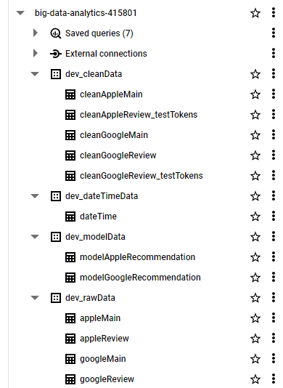
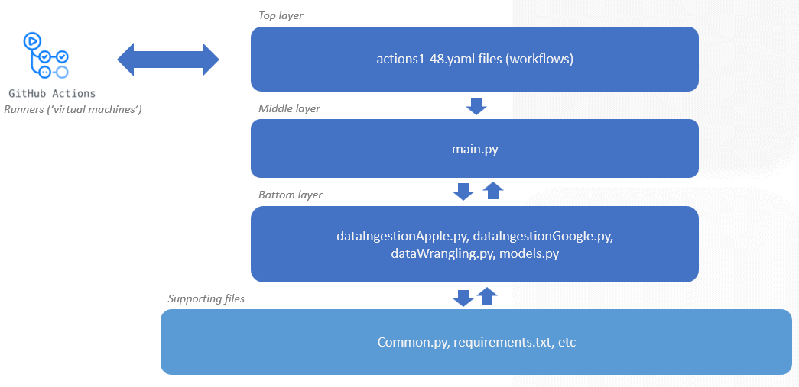
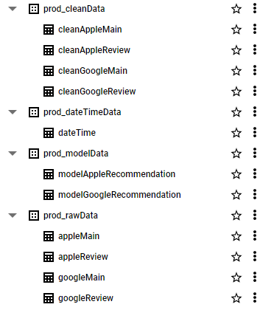
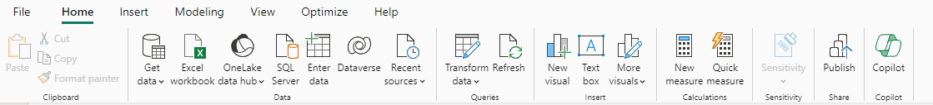
Overall Architecture Summary
Weekly (Sat)
1. (Repo structure)
2. (Google Big Query Data Warehouse)
3. (Power BI)
Notes:
In summary, this is how our entire architecture will be. We have scheduled our batch load to run weekly on Saturdays. So when it happens, the Runners will automatically read the codes and, using the functions created in the bottom layer, deposit the data into the different folders along the pipeline >> ingesting, cleaning and modelling the data along its way.
In addition, we also created a table to store the date and time each time a run is completed.
The final model outputs, along with the cleaned data and dateTime table, will then be read into power bi for further analysis and visualisation. The entire data in the dashboard can thus be refreshed at the end of each week by simply clicking the ‘refresh button’.

Slide 30
Exploratory ML and RCS
Machine Learning and Recommender System Exploration

Slide 31
Project Objectives
Approach
Analyze Key Factors/Features that drive app installs
Explore predictive models on app installs
Build various classification models
If the model’s prediction outcome is good, explore feature importance to derive insights

Slide 32
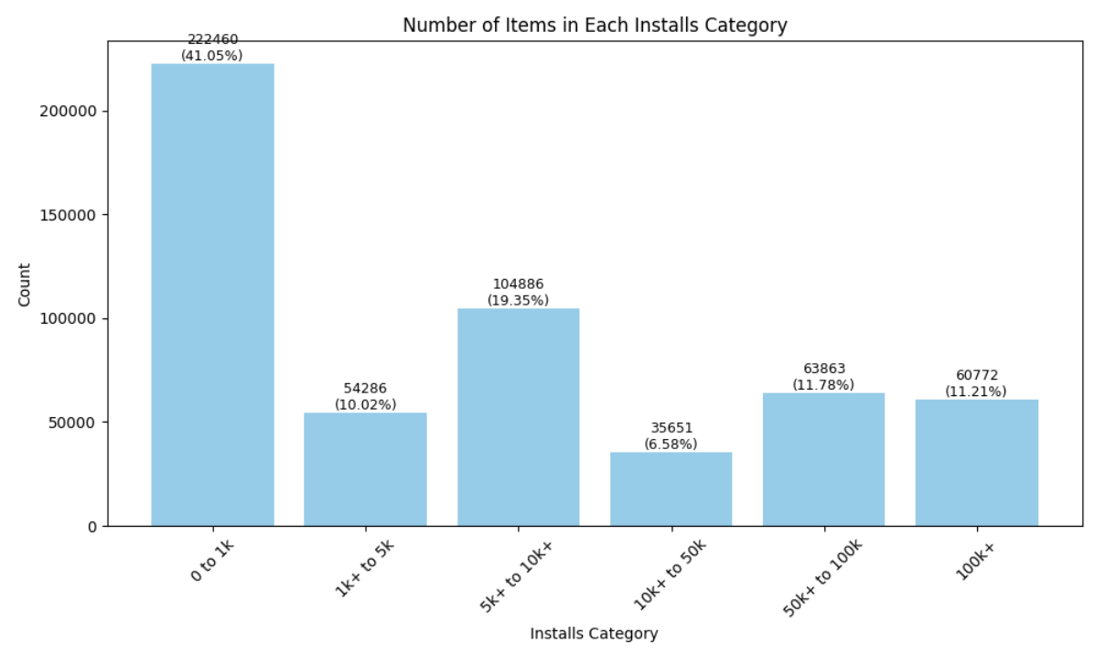
Categorical Variable Prediction
70% of features are categorical variables
Decision tree and random forest models chosen for their ability to handle non-linear inputs
App Characteristics:
Genre
Content Rating
Ad Supported
Free
Offers In-App Purchases
Price
Score
App Performance
Number of installs
Using PySpark’s Multiclass Classfification Evaluator
Notes:
App Characteristics:
- 1) Genre: Nature of the app, such as tools, events, social, finance, etc.
2) Content rating: Indicates whether the app is suitable for all ages or recommended for people with certain age and above, for example aged 17 and above.
3) Ad supported: Indicates whether the app developer allows other companies to publish marketing ads on the app.
4) Free: Indicates whether the developer charges users a fee for installing and using the app.
5) Offers In-ad purchases: Indicates whether users can make additional purchases after installing the app.
6) Score: Represents the average score of user ratings.
7) Price:

Slide 33
Initial Models
Performance Matrix | Decision Tree | Random Forest
Accuracy rate | 45.62% | 45.55%
Precision rate | 35. 06% | 32.74%
Recall rate | 45.62% | 45.55%
F1-score | 36.67% | 38.09%
* Evaluated using PySpark’s Multiclass Classification Evaluator

Slide 34
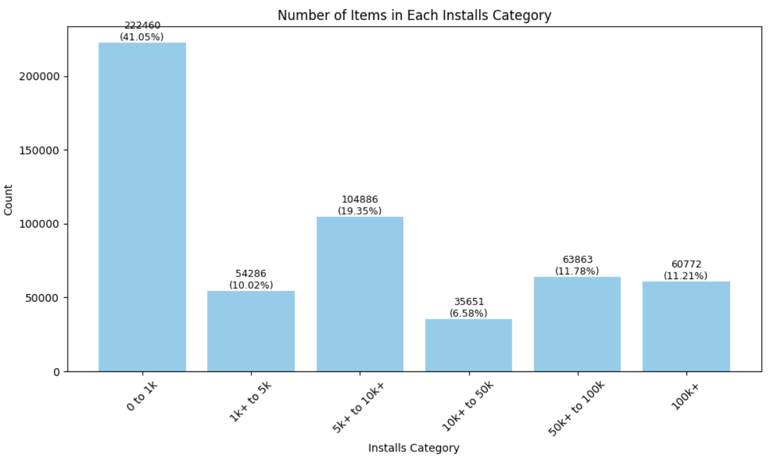
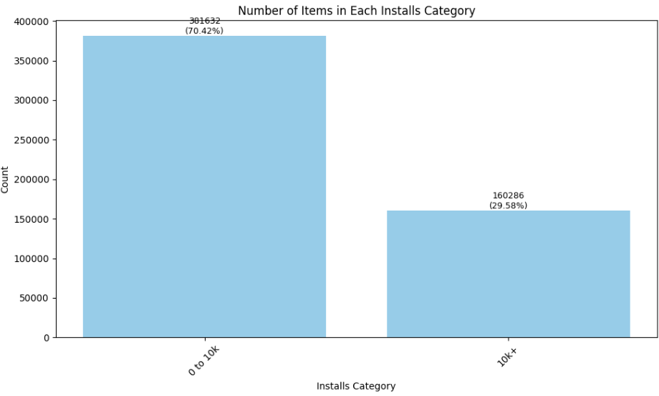
Output Variable Reduction
Bin the target variable into two categories based on the 70th percentile threshold for better model performance

Slide 35
Revised Models
 |  | 80% - 20% Sample Split |  |  | 70% - 30% Sample Split
 |  | Decision Tree | Random Forest (50 trees; 10 max depth) | Random Forest (80 trees; 10 max depth) | Decision Tree | Random Forest (50 trees; 10 max depth) | Random Forest (80 trees; 10 max depth)
Overall Model Performance (using PySpark’s Multiclass Classification Evaluator) | Accuracy rate | 75.09% | 74.99% | 75.06% | 74.96% | 74.97% | 74.99%
 | Precision rate | 73.61% | 73.73% | 73.93% | 73.36% | 73.54% | 73.59%
 | Recall rate | 75.09% | 74.99% | 75.06% | 74.96% | 74.97% | 74.99%
 | F1-score | 71.82% | 74.36% | 74.49% | 71.64% | 74.25% | 74.28%
Utilizing PySpark's Multiclass Classification Evaluator, the revised model demonstrates significantly improved performance, with all metrics above 70%
To focus specifically on the model performance for the 70th percentile class, we recomputed the metrics
Notes:
Low recall – missed opportunity!

Slide 36
Revised Models
Exploratory ML and RCS
Machine Learning and Recommender System Exploration
 |  | 80% - 20% Sample Split |  |  | 70% - 30% Sample Split
 |  | Decision Tree | Random Forest (50 trees; 10 max depth) | Random Forest (80 trees; 10 max depth) | Decision Tree | Random Forest (50 trees; 10 max depth) | Random Forest (80 trees; 10 max depth)
App Success Prediction | Accuracy rate | 75.09% | 74.99% | 75.06% | 74.96% | 74.97% | 74.99%
 | Precision rate | 67.06% | 68.59% | 69.41% | 66.21% | 67.54% | 67.73%
 | Recall rate | 31.31% | 28.81% | 28.33% | 30.78% | 29.07% | 28.98%
 | F1-score | 42.69% | 40.58% | 40.23% | 42.03% | 40.65% | 40.59%
Confusion Matrix
Low recall rate indicates a high chance of missed opportunities, as the model fails to identify a significant portion of profitable investment opportunities
This could lead to missed revenue and growth opportunities for app developers
Notes:
Low recall – missed opportunity!

Slide 37
Revised Models
 | 80% - 20% Sample Split |  |  | 70% - 30% Sample Split
 | Decision Tree | Random Forest (50 trees; 10 max depth) | Random Forest (80 trees; 10 max depth) | Decision Tree | Random Forest (50 trees; 10 max depth) | Random Forest (80 trees; 10 max depth)
Top 3 Features | Offer In-ad purchases - 45.19% Genre - 18.29% Ad supported – 17.57% | Genre – 43.71% Content rating – 24.48% Score – 14.14% | Genre – 43.80% Content rating – 23.57% Score – 14.89% | Offer In-ad purchases – 45.47% Genre – 18.60% Ad supported – 17.55% | Genre – 43.01% Content rating – 24.50% Score – 14.68% | Genre – 45.96% Content rating – 23.22% Score – 14.35%
App genre consistently ranks among the top three features in all the revised models, indicating its significant influence on app installs
Focusing investments on these top genres can potentially lead to better app performance and higher user engagement
These genres have been included in the monitoring dashboard for further analysis and focus
Notes:
Low recall – missed opportunity!

Slide 38
Competitor Analysis using
Content-Based Recommender System
Competitor App 4
[5k installs]
Competitor App 1
[> 10k installs]
Implement content-based recommender system to identify similar competitor apps
Perform competitor analysis to understand the performance of direct competitors
Gain insights into competitor strategies and market trends
Enhance app development and marketing strategies based on competitor analysis
New App
Competitor App 3
[1k installs]
Competitor App 2
[1k installs]
Notes:
Low recall – missed opportunity!

Slide 39
Data Input
Option 1
Structured Data
# of Installs
Score
Reviews
Price
Free
Genre
Content Rating
Ad Supported
Option 2
Unstructured Data
App title
Description
Option 3
Mixed Data
Features from Option 1
Features from Option 2
Notes:
Low recall – missed opportunity!

Slide 40
Top 5 Similar Apps
Best Approach
Testing App: Password Guardian | Option 1: Structured Data (App Features) | Option 2: Unstructured Data (App Title and Description) | Option 3: Mixed Data
K-Nearest Neighbors (ball-tree algorithms) | Fun! CPU! : showing CPU usage Astral Void - Sci-Fi Game Slappy Paddles : arcade game The Hera Hera Kingdom DX : puzzle game SHUFFLE 2D Arcade | RevBits PAM Security App : store password Mistikee : generate & manage password Roundshield password generator Phone’s ABI (Application Binary Interface (ABI) | Waste My Time – New Worlds : game The Hera Hera Kingdom DX : puzzle game Know, Made in : barcode scanner Assortments : matching game Twin Ships : game
4 out of 5 Apps : Games
3 out of 5 Apps : Password Related App
4 out of 5 Apps : Games
Notes:
Low recall – missed opportunity!

Slide 41
Models Exploration
Best Approach
Testing App: Password Guardian | K-Nearest Neighbors (ball-tree algorithms) | Cosine-Similarity | Doc2Vec Embeddings
Top 5 Similar Apps | RevBits PAM Security App : store password Mistikee : generate & manage password Roundshield password generator Phone’s ABI (Application Binary Interface (ABI) | Security App : store password Roundshield password generator Unmask – Your Privacy : store password Masterkey : password manager NEKTA Cloud : unique service for collecting and processing data in IoT | kpnPass Password Manager Password Cerber : store password KG Password Generator – Genera MultiPass : secure identification & access code TriGen : identify authenticator app
Password related apps:
3 out of 5
Password related apps:
4 out of 5
Password / Security related apps:
5 out of 5
Notes:
Low recall – missed opportunity!

Slide 42
Dashboard
Power BI at a glance

Slide 43
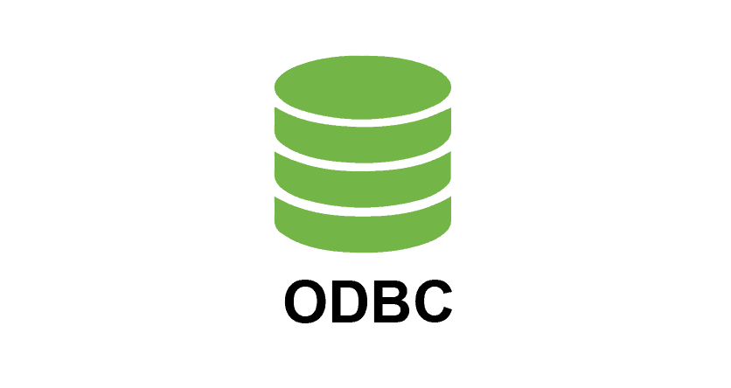
BIG DATA
rchitecture
Exploratory ML and RCS
Machine Learning and Recommender System Exploration
Cloud Data Lake/Warehouse
Business Intelligence
Data Lake
Data Warehouse
rawData
cleanData
modelData
ODBC Driver (Simba)
Service account (GBQ)
ODBC Data source (server PC)
PowerBI (GBQ Via ODBC)
rawData
cleanData

Slide 44
Dashboard Overview: Insights into App Market Trends and Strategies
Trend Analysis:
Descriptive analysis on Google and Apple apps
Analyze distribution of apps across different genres and their popularity on both the Apple App Store and Google Play Store
Market Comparison:
Comparative analysis between the Apple App Store and Google Play Store: uncovering unique trends in each platform, providing insights to developers and optimizing their app strategies
Recommender System:
Recommendation to new app developers of existing applications in the market, their market share and similarities
Text Analytics:
Application description
User reviews

Slide 45

Trend Analysis
Distribution of
Genre
Free VS Paid Apps
Top developers
Trending genre over time
Popularity of different genres based on factors e.g. installation counts
Developer analysis based on
Rating score
Installation counts

Slide 46

Trend Analysis
Distribution of
Genre
Free VS Paid Apps
Top developers
Trending genre over time
Popularity of different genres based on factors e.g. installation counts
Developer analysis based on
Rating score
Installation counts

Slide 47

Trend Analysis
Distribution of
Genre
Free VS Paid Apps
Top developers
Trending genre over time
Popularity of different genres based on factors e.g. installation counts
Developer analysis based on
Rating score
Installation counts
0.8M

Slide 48

Market Comparison
Compare key metrics of each platform:
Average Rating scores
Analyze the different price points between two platforms.
Analyze user feedback between different Genre
Word cloud based on user reviews to identify common feedback themes and sentiments
Notes:
Apple users tend to be more generous in giving 5-star reviews.
Price point are comparable between 2 platform.

Slide 49



Recommender Model
Recommendation on similar apps based on New App’s genre and description.
Provide developers with insights on:
Similarity Analysis: Gauge how unique/creative the new app is comparing to existing apps.
Market share analysis: Gain insights on how the competitors performing currently in terms of review score.
Size of square: review score
Color scheme: Darkest with the highest similarity rank

Slide 50
Recommender Model
Recommendation on similar apps based on New App’s genre and description.
Provide developers with insights on:
Similarity Analysis: Gauge how unique/creative the new app is comparing to existing apps.
Market share analysis: Gain insights on how the competitors performing currently in terms of review score.
Size of square: review score
Color scheme: Darkest with the highest similarity rank

Slide 51



Recommender Model – Explicit User Feedback Data Collection
Customized modelling analysis for new app by getting the following inputs from user:
Name
Description
Summary

Slide 52
Conclusion
Monitoring, Logging, Conclusion & Retrospective

Slide 53

Challenges
Pre and Post Data Collections

Slide 54


Challenges
Pre-data collection
Data availability & Data quality
Data ingestion
Scalability
Model monitoring
Cost of Data Acquisition
Post data collection

Slide 55



Challenges: Pre-Data collection
Ingestion
Data Source
Web-scraping
Noise and biases
Inconsistent attributes between platforms
Solution:
Data cleaning and preprocessing
Inconsistent attribute imputation and normalization
Ingestion failures
Timeout and throttling issues – excessive API calls
Solution:
Error logs
Iterative improvements
Data Extraction
Strategic inserts of print() statements at key steps/functions to aid troubleshooting

Slide 56



Challenges: Post Data collection
Data source scalability
Weekly data refreshes from different regions
Solution:
Integration with APIs for comprehensive datasets
Model monitoring and evaluation
Model drift and data drift
Solution:
Drift detection and handling
Dashboard monitoring
Model monitoring
& Evaluation
Detect drift
ADWIN
DDM
EDDM
Handle drift
Concept drift
Data drift

Slide 57



Challenges: Cost of Data Acquisition
Cost - effective data acquisition process
Future data acquisition costs VS benefits consideration

Slide 58


Time Management
Data Ingestion, Prep and Modelling

Slide 59

Future Improvement Areas
Data quality enhancement
Advance cleaning techniques
Streamline feature engineering techniques
Enrich modelling
Incorporate features such as user demographic data
Optimization of Recommendations
Provide additional insights to new app developers
Enhance recommended app strategies
Scalability solution
Refinement of current batch processing and API integrations for scalability
Implementation of automated data processing pipeline using Kubernetes

Slide 60



